Slide 1

ASP.Net Core
Nobel It solutions

Slide 2
ASP.Net Core
What is ASP.Net Core?
ASP.NET Core is an open source and cloud-optimized web framework for developing modern web applications that can be developed and run on Windows, Linux and the Mac. It includes the MVC framework, which now combines the features of MVC and Web API into a single web programming framework.
ASP.NET Core apps can run on .NET Core or on the full .NET Framework.
It was architected to provide an optimized development framework for apps that are deployed to the cloud or run on-premises.
It consists of modular components with minimal overhead, so you retain flexibility while constructing your solutions.
You can develop and run your ASP.NET Core apps cross-platform on Windows, Mac and Linux.

Slide 3
Advantages of ASP.Net Core
ASP.NET Core has a number of architectural changes that result in a much leaner and modular framework.
ASP.NET Core is no longer based on System.Web.dll. It is based on a set of granular and well factored NuGet packages.
This allows you to optimize your app to include just the NuGet packages you need.
The benefits of a smaller app surface area include tighter security, reduced servicing, improved performance, and decreased costs.

Slide 4
Get Improvement with ASP.Net Core
Build and run cross-platform ASP.NET apps on Windows, Mac and Linux.
Built on .NET Core, which supports true side-by-side app versioning.
New tooling that simplifies modern Web development.
Single aligned web stack for Web UI and Web APIs.
Cloud-ready environment-based configuration.
Built-in support for dependency injection.
Tag Helpers which makes Razor markup more natural with HTML.
Ability to host on IIS or self-host in your own process.

Slide 5
ASP.Net Core Template
Connected Services: The 'Connected Services' node contains the list of external services, APIs, and other data sources. It helps in the integration with various service providers, such as Azure, AWS, Google Cloud, and third-party services like authentication providers or databases. We are not using any service yet so it will be empty for now.
Properties : The Properties folder contains the file launchSettings.json. This json file contains all the project-specific settings needed to launch the application. You will find debug profile, environment variables that should be used, etc in this file.
Dependencies: This folder contains all the Dependencies of the project. The Visual studio uses NuGet Packages for all the server-side dependencies. For the Client-Side dependencies, the Libman is used. This is a deviation from the previous versions where NuGet is used for both for Server & Client-side dependencies. Under the Dependencies folder, we have Packages, Frameworks & Analyzers folder.
Program.cs File: The Program class contains the entry point of the ASP.NET Core applications. There is no main method in this file. It is implicit. All the tasks which was done in startup class, is now moved here starting from version .NET 6.0. We configure the applications request pipeline & Middlewares in the program.cs. We also configure the services and add them to the dependency injection container.
The default program.cs file from .NET 6.0 and above.

Slide 6
ASP.Net Core Template
Appsettings.json : The appsettings.json file is a configuration file commonly used in .NET applications, including ASP.NET Core and ASP.NET 5/6, to store application-specific configuration settings and parameters. It allows developers to use JSON format for the configurations instead of code, which makes it easier to add or update settings without modifying the application's source code.

Slide 7
Middleware
ASP.NET Core introduced a new concept called Middleware. A middleware is nothing but a component (class) which is executed on every request in ASP.NET Core application. In the classic ASP.NET, HttpHandlers and HttpModules were part of request pipeline. Middleware is similar to HttpHandlers and HttpModules where both needs to be configured and executed in each request.
There will be multiple middleware in ASP.NET Core web application. It can be either framework provided middleware, added via NuGet or your own custom middleware. We can set the order of middleware execution in the request pipeline. Each middleware adds or modifies http request and optionally passes control to the next middleware component. The following figure illustrates the execution of middleware components.

Slide 8
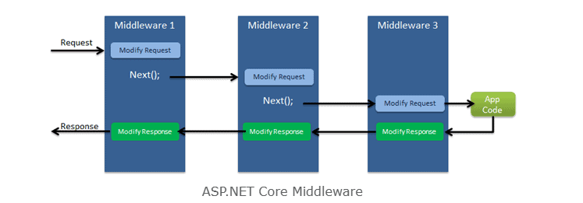
Middleware

Slide 9
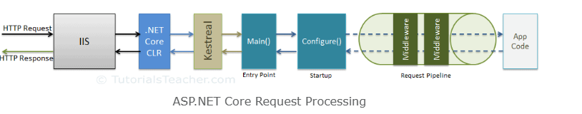
Middleware Request Processing

Slide 10
Middleware
Middleware are software components that are assembled into an application pipeline to handle requests and responses.
Each component chooses whether to pass the request on to the next component in the pipeline, and can perform certain actions before and after the next component is invoked in the pipeline.
Request delegates are used to build the request pipeline. The request delegates handle each HTTP request.
Each piece of middleware in ASP.NET Core is an object, and each piece has a very specific, focused, and limited role.
Ultimately, we need many pieces of middleware for an application to behave appropriately.

Slide 11
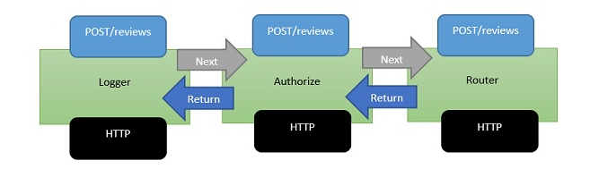
Example of Middleware

Slide 12
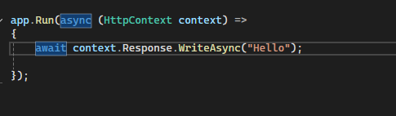
App.Run()
The extension method called Run is used to execute a terminating/short circuiting middleware that does not forward the request to next middleware.
The Run method allows us to pass in another method, which we can use to process every single response. Run is not something that you will see very often, it is something that we call a terminal piece of middleware.

Slide 13
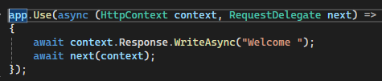
App.Use()
The extension method called 'Use' is used to execute a non-terminating /short-circuiting middleware that may /may not forward the request to next middleware.

Slide 14
Middleware Class
Middleware class is used to separate the middleware logic from lambda expression to a separate/reusable class.
The custom middleware component is like any other .NET class with Invoke() method. However, in order to execute next middleware in a sequence, it should have RequestDelegate type parameter in the constructor.

Slide 15
Environment
An environment represents is a system in which the application is deployed and executed.
Development: The environment where the developer makes changes in the code, commits code to the source control.
Staging: The environment, where the application runs on a server from which other developers and quality controllers access the application.
Production: The environment where the real end-users access the application. Shortly, It's where the application "live" to the audience.

Slide 16
Properties & Methods
EnvironmentName: Gets or sets name of the environment. By default it reads the value from either DOTNET_ENVIRONMENT or ASPNETCORE_ENVIRONMENT.
ContentRootPath: Gets or sets absolute path of the application folder.
IsDevelopment(): Returns Boolean true, if the current environment name is "Development".
IsStaging(): Returns Boolean true, if the current environment name is "Staging".
IsProduction(): Returns Boolean true, if the current environment name is "Production".
IsEnvironment(string environmentname): Returns Boolean true, if the current environment name matches with the specified environment.

Slide 17
Routing
Routing is a process of matching incoming HTTP requests by checking the HTTP method and url and then invoking corresponding endpoints.
Key components of routing in ASP.NET Core
Route Template: A route template defines the structure of a URL and includes placeholders for route values. For example, /products/{id} is a route template with a placeholder {id}.
Route Values: Route values are extracted from the URL based on the placeholders defined in the route template. In the above example, id is a route value.
Route Constraints: Constraints are used to restrict which URLs match a route template. For instance, you can constrain id to only match numeric values.
Route Parameters: Route parameters are placeholders in controller action methods that correspond to route values. They receive values from the route values extracted from the URL.

Slide 18
UseRouting() & UseEndPoints()
UseRouting(): Enables routing and selects an appropriate end point based on the url path and HTTP method.
UseEndPoints(): Executes the approriate endpoint based on the endpoint selected by the above UseRouting() method.
GetEndpoint(): Returns an instance of Microsoft.Asp.NetCore.Http.Endpoint type, which represents an endpoint.
That instance contains two important properties: DisplayName, RequestDelegate.

